Slide 1
Machine learning
Chris Geggis
1/26/2023

Slide 2
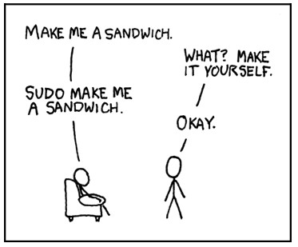
Attendance or quiz?
Comic credit: xkcd (Randall Munroe)

Slide 3
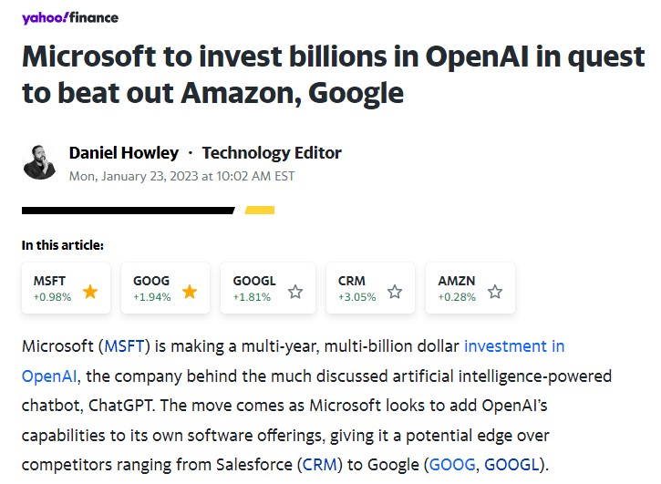
Monday Headline

Slide 4
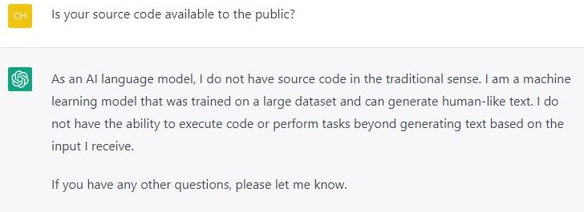
Chatgpt

Slide 5
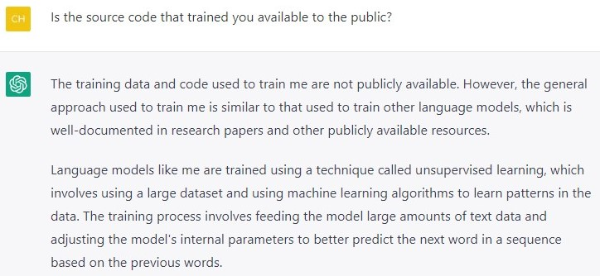
chatgpt

Slide 6
Machine learning models
Table lookup (simplest instance-based method)
Supervised Learning (training data)
Decision Trees
Ensemble Learning
Deep Learning

Slide 7
More machine learning models
Convolutional Networks
Recurrent Neural Networks (RNNs)
Unsupervised Learning (Clustering and Reinforcement [below])
Transfer Learning
Reinforcement Learning (active and passive)

Slide 8
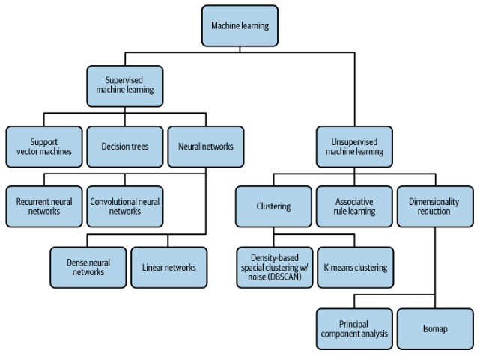
Another mL map

Slide 9
Parametric models
Fixed parameters
More restrictive
Run Faster
Easier to train
Good for input data that is well defined
Examples include: Linear Regression, Neural Networks

Slide 10
Nonparametric models
Not based on a math model
These models learn from the data itself
Good for problems where the input data is not well-defined or is too complex to be modeled with a parametric model
Examples include: Decision trees, Support Vector Machines

Slide 11
Kaggle competition
Kaggle Competition Website

Slide 12
Terms you should pick up on
Supervised vs Unsupervised Learning
Classification vs Regression
Parametric vs Nonparametric
Parameters vs Hyperparameters
Models, hypothesis (space)
Clustering

Slide 13
More ml terms
Agent, Environment
Training, Test, and Validation Datasets
Contextual Evidence
Arrays, Matrices, Tensors
Data Mining, Labeling

Slide 14
Debugging
import pdb; pdb.set_trace()
OR
$ python –m pdb MyProg.py

Slide 15
Helpful tricks
Minimal Installation, Double disk, Double video memory
$ sudo visudo
Append this line to the end of the file
yourusername ALL=(ALL) NOPASSWD:ALL
Test with
$ sudo su -

Slide 16
More helpful stuff
In Settings…Under Privacy…Screen…
Turn Off Automatic Screen Lock
Set Blank Screen Delay to Never
Increase screen resolution (if possible)
Install Guest additions (Mainly to aid in cut and paste)

Slide 17
Important Commands
sudo apt-get update
sudo apt-get install make gcc python2

Slide 18
Foundations of ML
(More than a) Footnote: The difference between AI and ML
The Turing Test (Natural Language Processing, Knowledge Representation, Automated Reasoning, and Machine Learning)
The Total Turing Test – add Computer Vision and Robotics

Slide 19
Foundations of ML
Thinking humanly: The cognitive modeling approach
introspection – trying to catch our own thoughts as they go by
psychological experiments – observing a person in action
brain imaging – observing the brain in action (fMRI)

Slide 20
Foundations of ML
Cognitive Science brings together the computer models from AI and experimental techniques from psychology to construct precise and testable theories of the human mind.
How our brains work is sometimes very similar to how a computer learns, and sometimes very different
Planes don’t fly the way birds do, ML (sometimes) doesn’t work the way your brain does
Our brains are mostly designed to move our bodies around in a way that facilitates human survival. Amusement, in various forms, is something that many human brains search for.

Slide 21
Foundations of Ml
Linguists currently believe that all modern script originated from Serabit el-Khadim
Proto-Sinaitic script - Wikipedia link
Socrates is a man AND All men are mortal THEREFORE Socrates is mortal
Ancient Greece (as far as we can tell today) gave birth of the study of formal logic
Aristotle, syllogisms, attempted to codify “right thinking”
We use logic for past events, probability for future events
Euclid created the first algorithm to compute greatest common divisors about 2300 ya

Slide 22
Foundations of Ml
“Rational” (Do the logical/right thing) Agents: Operate autonomously, perceive their environment, persist over a prolonged time period, adapt to change, create and pursue goals
Value alignment problem - machines should be pursuing human goals as opposed to their own, preferably provably beneficial to humans

Slide 23
FOUNDATIONS of ML
The Golden Age of Islam OR Islamic Golden Age (~622 - ~1258)
The term algorithm comes from Muhammad ibn Musa al-Khwarizmi (early 800s). He is considered the father of algebra and he also introduced the Arabic number system to Europe
Guttenberg Printing Press (1440ish)
Rene Descartes (1596-1650) - Cartesian coordinate system and much philosophy including dualism (animals are like machines that humans can use)
Wilhelm Schickard constructed the first known calculating machine ~1623
Blaise Pascal (1623 – 1662) – Pascaline calculator

Slide 24
FOUNDATIONS of ML
Materialism – the brain operates according to the laws of physics
Physicalism/Naturalism – The world behaves according to science, not the supernatural
Empiricism – Science requires evidence
Induction – Science requires reproducibility to learn the rules. We learn by repetition.
Logical positivism – all knowledge characterized by logical theories connect via observation sentences and sensory inputs and this connects rationalism to empiricism

Slide 25
FOUNDATIONS of ML
Confirmation theory in Rudolf Carnap’s 1928 book was (possibly) the first theory of mind as a computational process
Methods based on logical planning actions to achieve definitive goals dominated the first few decades of theoretical research in AI
Utility captures the internal, subjective value of an outcome
John Stuart Mill (1863), utilitarianism is a specific kind of consequentialism. Right and wrong are determined by expected outcomes of an action

Slide 26
Foundations of ML
Immanuel Kant (1875) - deontological ethics, do the right thing, but don’t break the rules (Don’t kill, don’t lie)
Kurt Gödel’s incompleteness theorem showed that in any formal theory at least as strong as the elementary theory of natural numbers, there are necessarily true statements that have no proof within the theory.
Church-Turing Thesis - What is computable? (after the Incompleteness Theorem)
Tractability – is a problem intractable? (e.g. The Halting Problem)
NP-completeness provides a basis for analyzing the tractability of problems

Slide 27
Foundations of ML
Economics - Adam Smith, The Wealth of Nations (1776)
Decision theory combines probability theory with utility theory and provides a framework for individual decisions made under uncertainty
Game theory (John von Neumann and Oskar Morgenstern) includes the surprising result that for some games a rational agent should adopt randomized policies
Markov decision processes involves how decisions are made when sequence matters
Satisficing mirrors human behavior by making decisions that are “good enough”

Slide 28
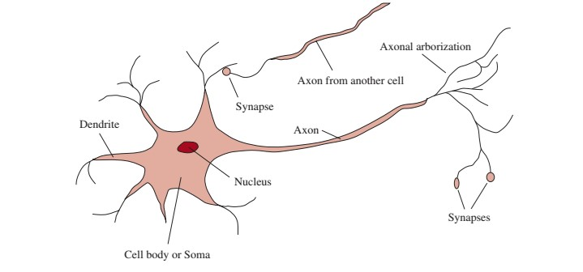
Foundations of ML
~86 Billion neurons | ~85 Billion non-neuron cells
fMRI

Slide 29
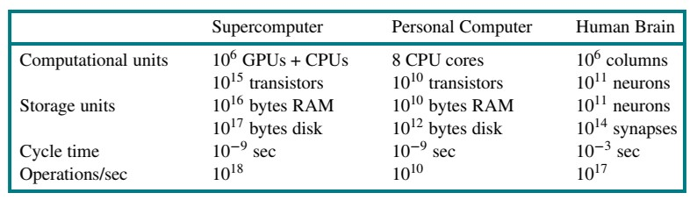
Foundations of ML
The singularity has multiple meanings in AI/ML, but mostly it’s when computers overtake human abilities

Slide 30
Foundations of ML
Human-Computer Interaction (HCI) – 1968 Doug Engelbart demos the computer mouse.
WWII, first computers created independently in three countries. England, Germany, and the US. John Mauchly and J Eckert’s design became the most influential.
Moore’s Law. Clock performance doubled every 18 months or so, until 2005, when manufactures started increasing the number of cores.
An ML model that took a day to train in 2014 takes only 2 minutes in 2018.
Quantum Computing holds promise.

Slide 31
Foundations of ml
Book states Charles Babbage’s machines (Analytical Engine) and Ada Lovelace’s ideas were largely forgotten. I disagree.
The cost function (referred to in the chapter) is important in neural networks and we will touch on it in more detail later. It involves multi-variable calculus, which we should understand, but we leave the math to the computer.
Noam Chomsky (mentioned, linguist) used to live nearby (Lexington) and teach at MIT
Marvin Minsky and Dean Edmonds built the first neural network computer as undergrads at Harvard in 1950

Slide 32
Foundations of ml
Claude Shannon (mentioned mathematician) is considered the father of information theory. Information cannot be destroyed, which is an interest in theoretical physics.
“Expert Systems” (1969 – 1986) used weak methods that did not scale well.
The hype did not live up to the promise
This period (and longer really) is known as the “AI winter”
One exceptional success was Digital Equipment Corporation’s (DEC) commercial R1 expert system

Slide 33
Foundations of ml
Mid-1980’s 4 different groups reinvented the back-propagation algorithm
MNIST dataset becomes a benchmark in the ’80s
Hidden Markov Models (HMMs) became widely used in the ‘80s
Bayesian Networks yielded a rigorous and efficient formalism for representing uncertain knowledge as well as practical algorithms for probabilistic reasoning

Slide 34
Foundations of ml
Big Data came on the scene as the result of the World Wide Web around the turn of the millennium
Deep Learning (sort of a main focus) and convolutional neural networks (we will go into more detail in later chapters) have become more widely used lately
https://aiindex.stanford.edu/

Slide 35
State of the art (Benefits)
Robotic vehicles (Waymo), legged locomotion (Boston Dynamics), autonomous planning and scheduling (NASA), machine translation (Google), speech recognition (MS, Google, Amazon), recommendations (Amazon, FB, Netflix, Spotify, YouTube, Walmart) , game playing (Chess, Jeopardy, and Go), image understanding (Google and ImageNet), medicine (recognition of diseases and cancer as good as or better than experts), climate science (recognizing brewing weather events buried in climate data)

Slide 36
Risks of ai/ml
Lethal autonomous weapons (UN Involvement)
Surveillance and persuasion (Cambridge Analytica, Deepfakes)
Biased decision making (A current major problem in AI/ML)
Impact on employment (A concern that has been around for a long, long time)
Safety-critical applications (Self-Driving Cars)
More detail when we get to Chapter 27

Slide 37
Assignment 2 for next week
On Blackboard (Word Doc) – Not too difficult, but very important

Slide 38
Hollywood ending Movie (pick of the week)
AlphaGo Movie (Documentary) (1 hr 30 min) 33M views on YouTube
With more board configurations than there are atoms in the universe, the ancient Chinese game of Go has long been considered a grand challenge for artificial intelligence. On March 9, 2016, the worlds of Go and artificial intelligence collided in South Korea for an extraordinary best-of-five-game competition, coined The DeepMind Challenge Match. Hundreds of millions of people around the world watched as a legendary Go master took on an unproven AI challenger for the first time in history.

